Slide 1
Welcome to the
2024
Flint River Council Adult Recognition Banquet

Slide 2
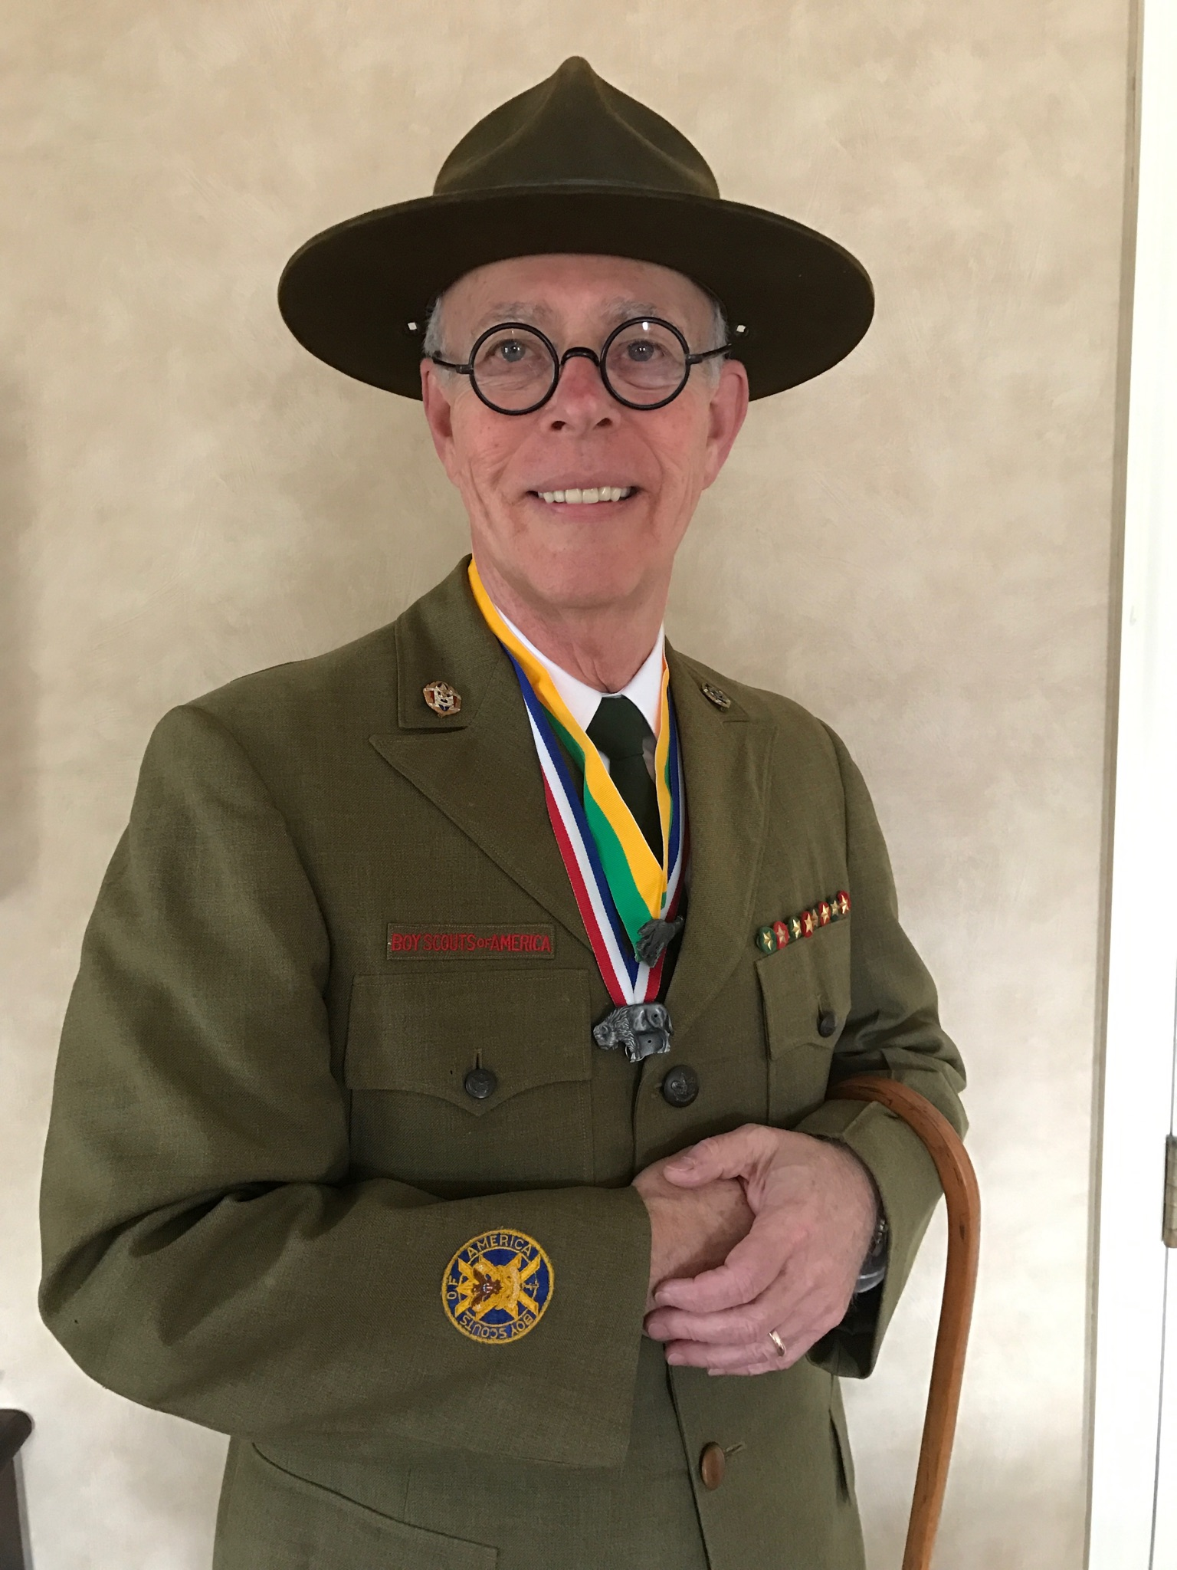
Master of Ceremonies
Bill Baldwin

Slide 3
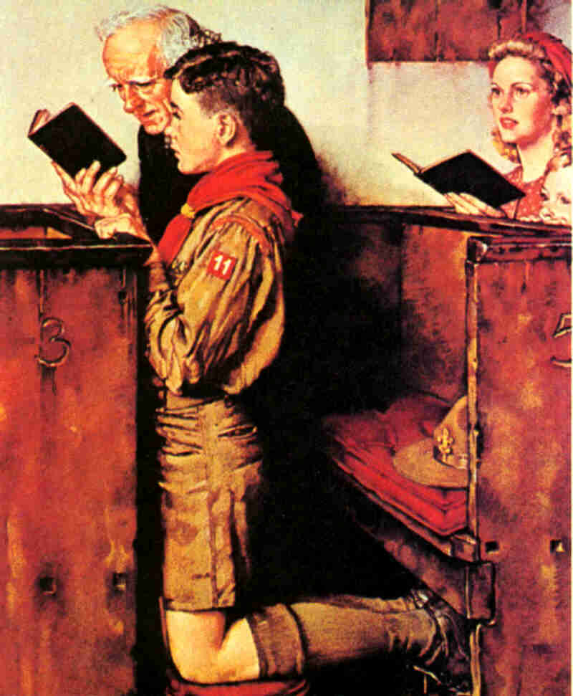
A Scout
is Reverent

Slide 4
Presentation of the Colors & Scout Oath & Law
Presented by
Flint River Council Commissioner Corp.

Slide 5
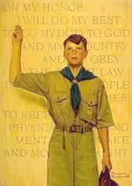
On my honor I will do my best
To do my duty to God and my country
And to obey the Scout Law;
To help other people at all times
To keep myself physically strong, mentally awake, and morally straight.

Slide 6
A Scout is…
Trustworthy
Loyal
Helpful
Friendly
Courteous
Kind
Obedient
Cheerful
Thrifty
Brave
Clean
And Reverent

Slide 7
The Flint River Council recognizes our Dignitaries and Special Guests...

Slide 8

2023 DISTRICT AWARD OF MERIT RECEIPENTS
RONOTOHACHI
MATT CHEBRO
COWETA
JAMES ANTONUCCI and DAVID VANDYKE
TUSSAHAW
LEVI WHITE

Slide 9
Please enjoy your meal…

Slide 10
Master of Ceremonies
Bill Baldwin

Slide 11

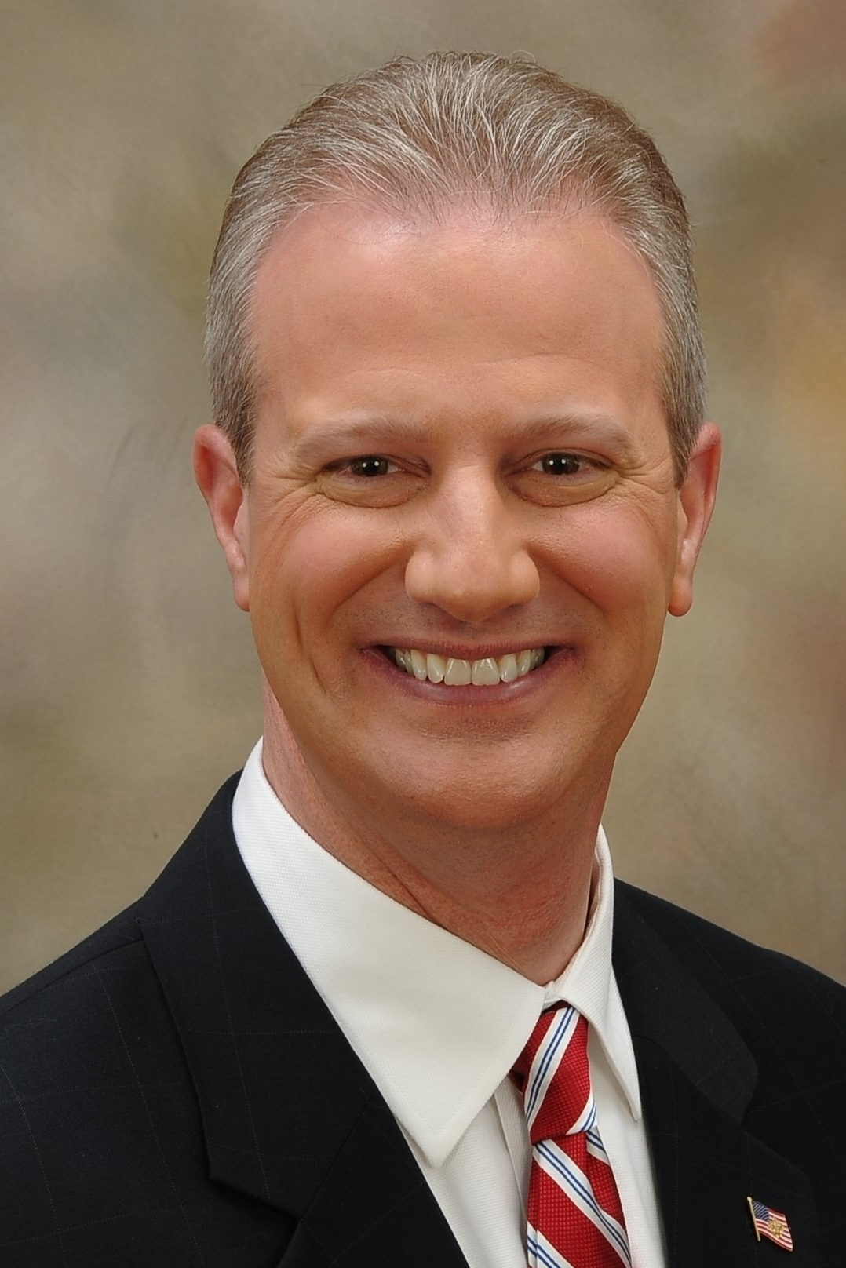
2024
Silver Antelope Recogntion
Frank Harper

Slide 12
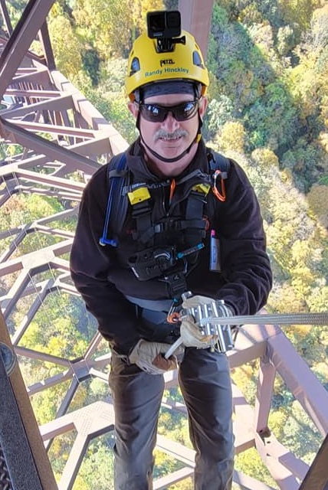
2024
Silver Antelope Recogntion
Randy Hinckley

Slide 13
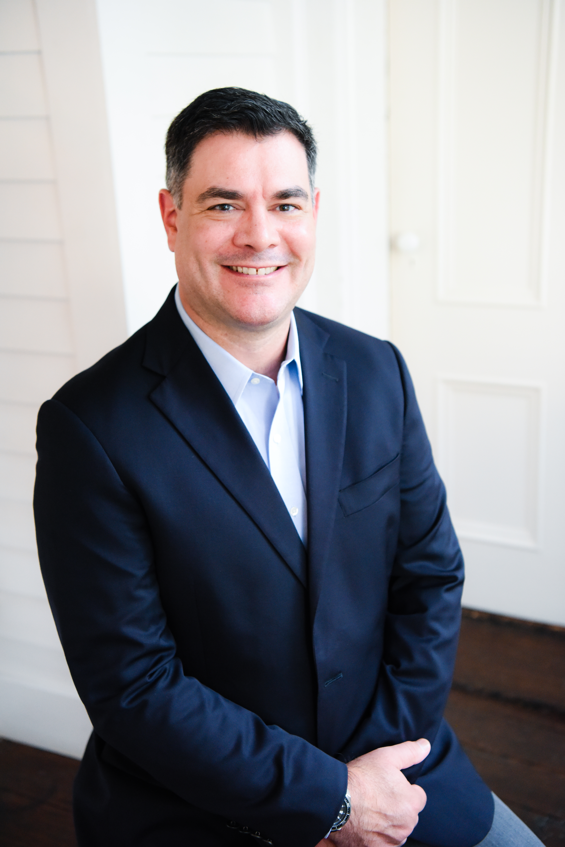

Council
Alumnus of
The Year
Award
Andy McCall

Slide 14
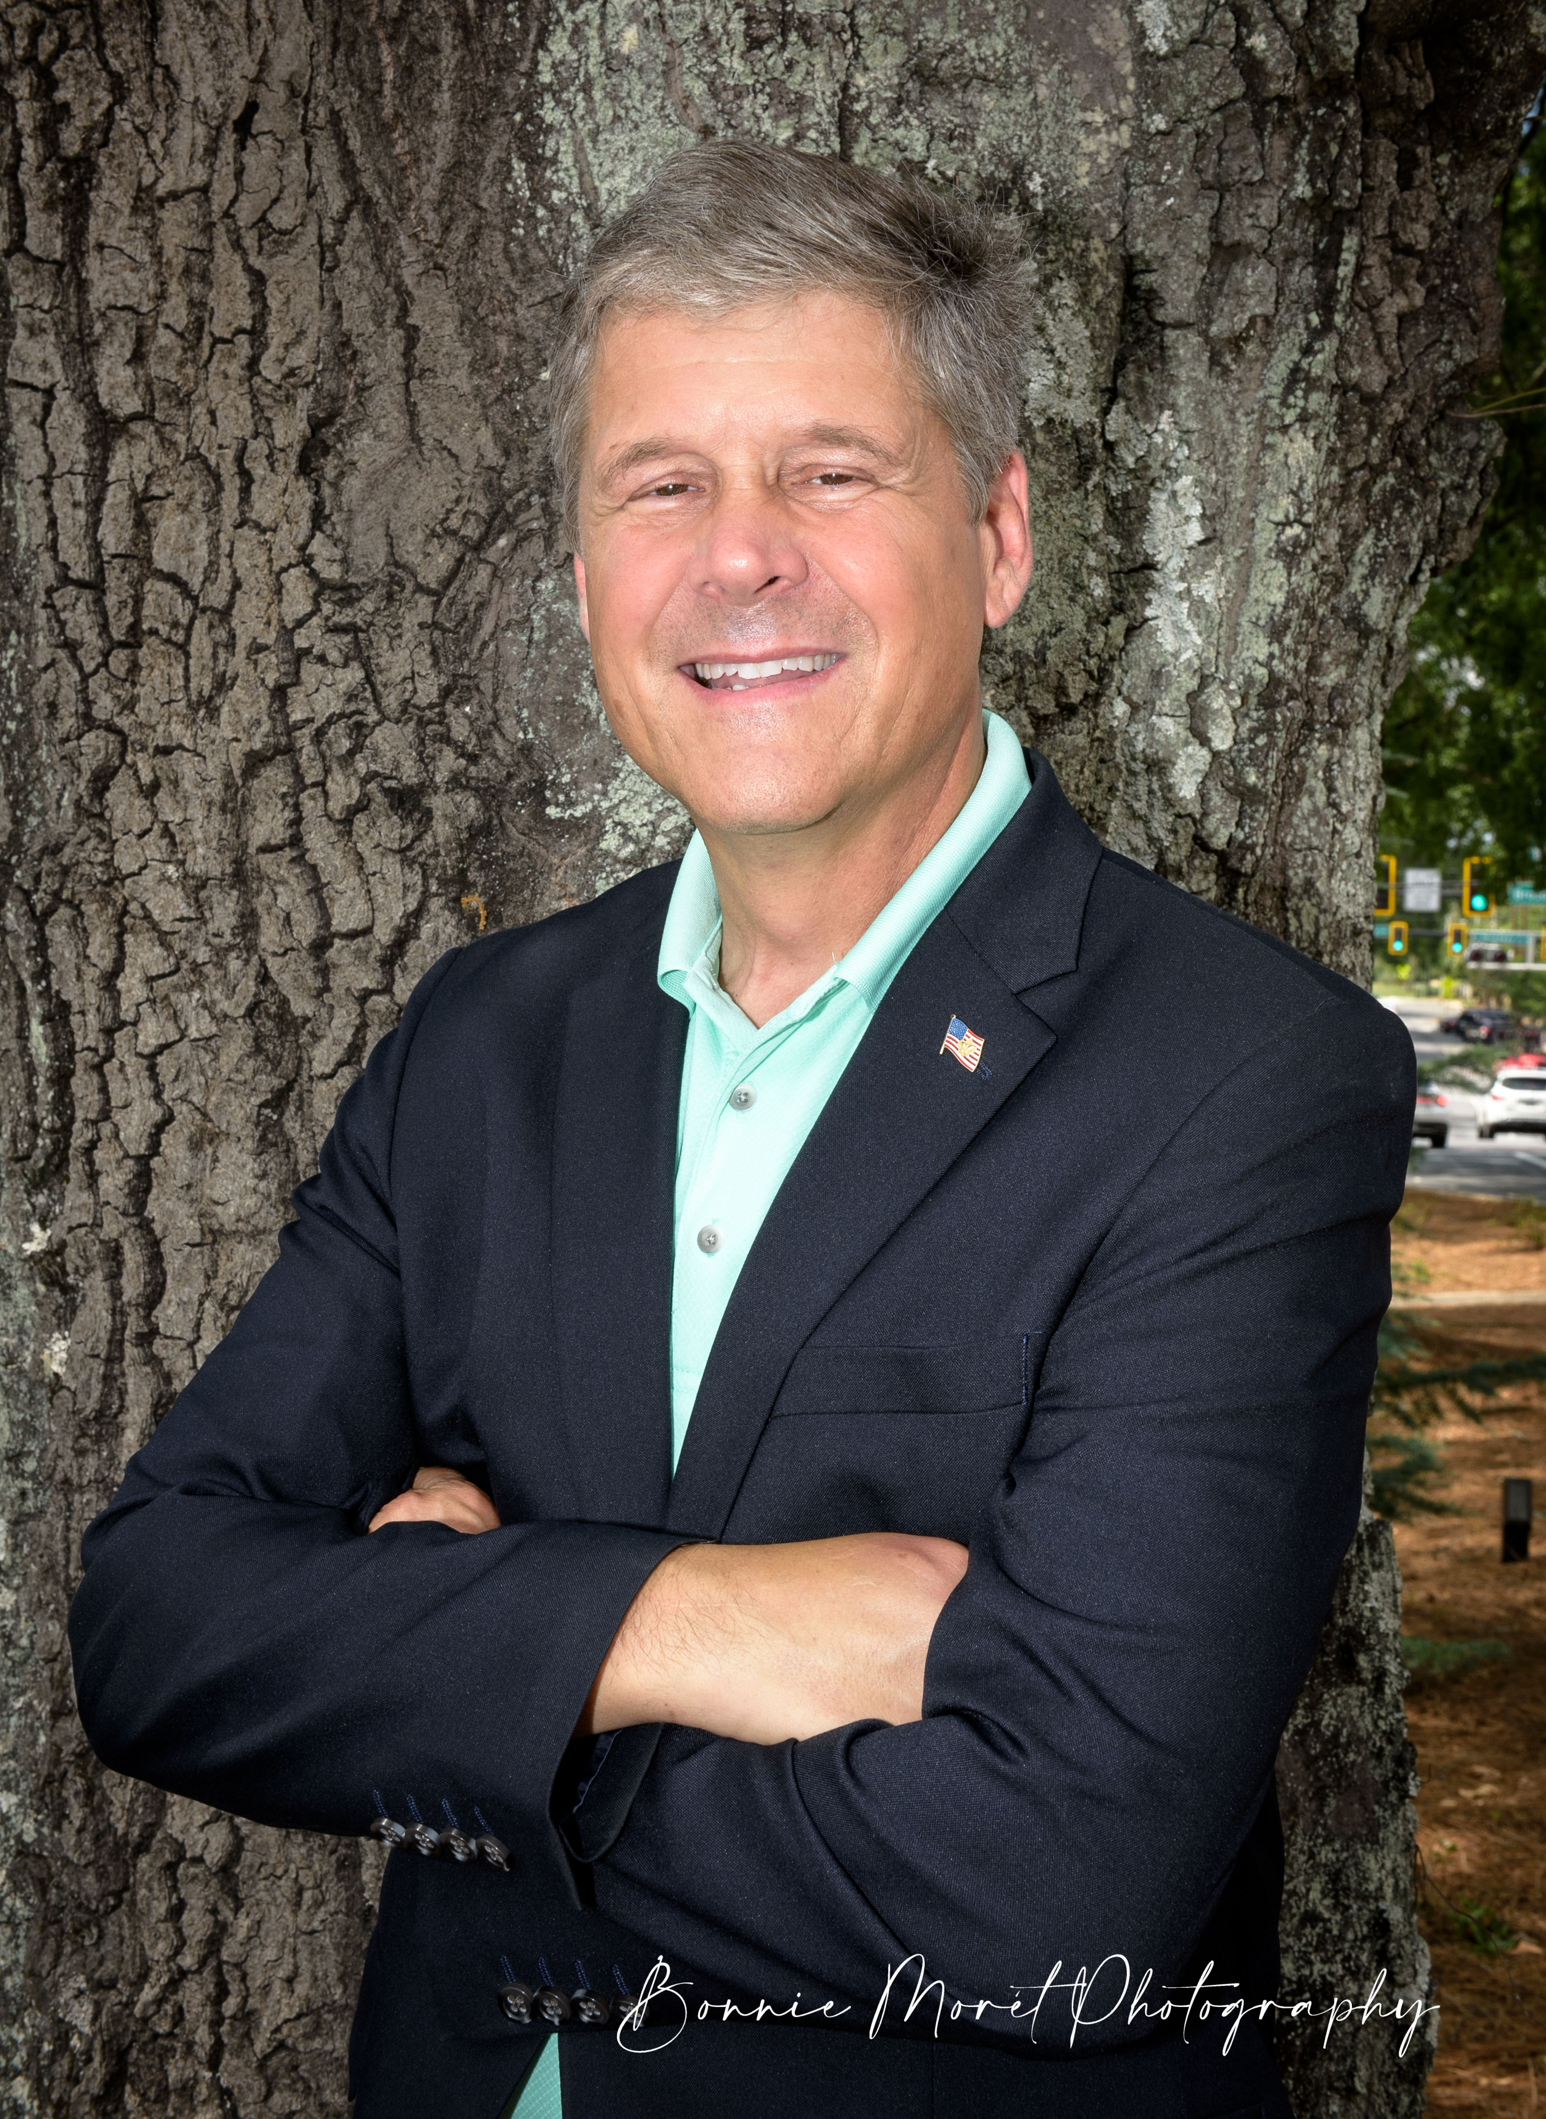
2023 Council
Alumnus of
The Year
Award
Doug Hollberg

Slide 15
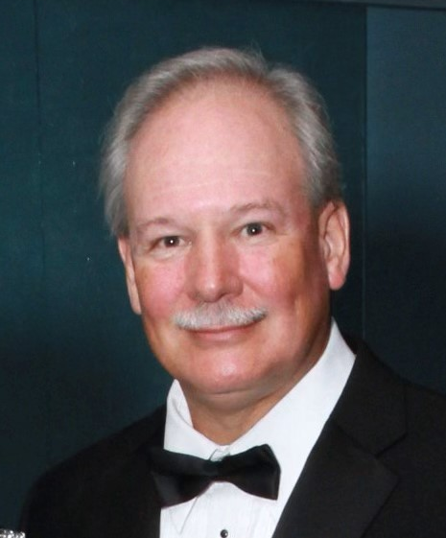

NESA
Outstanding
Eagle Scout
Award
Ken Palmer

Slide 16
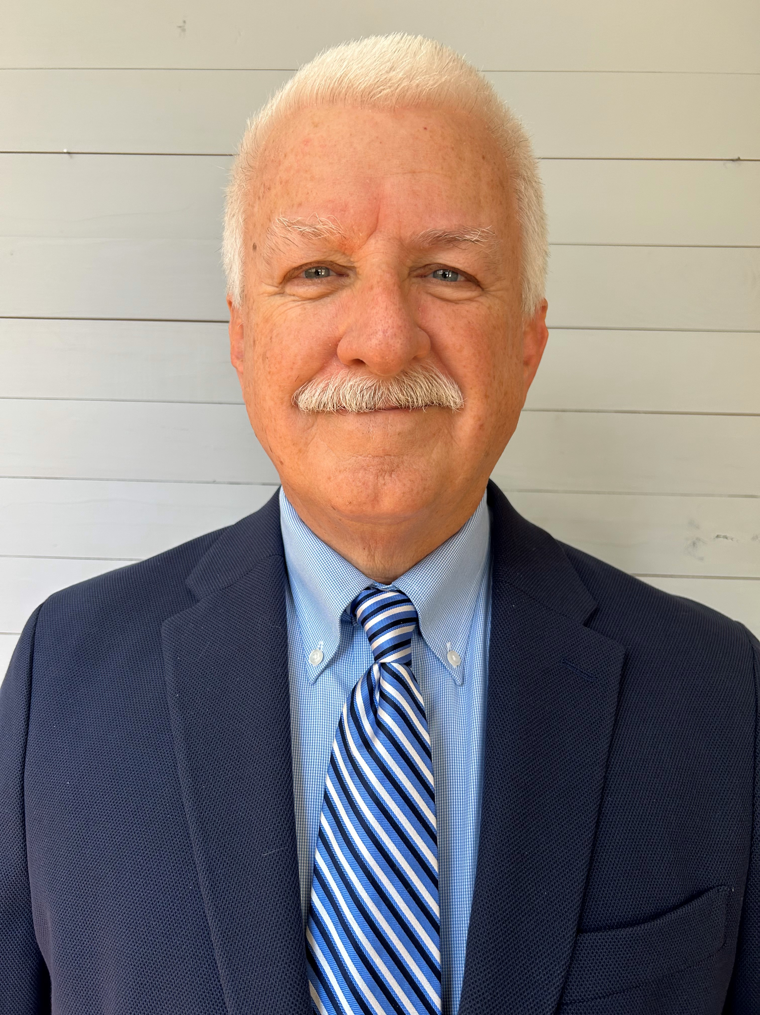
2023 NESA
Outstanding
Eagle Scout
Award
Jay Fralish

Slide 17
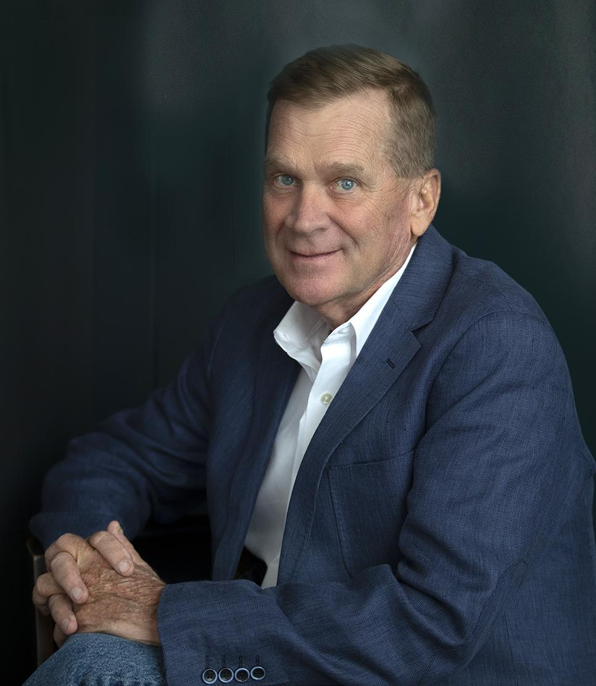
2023 NESA
Outstanding
Eagle Scout
Award
Dr. James C. Sams

Slide 18
Master of Ceremonies
Bill Baldwin

Slide 19
Silver Beaver Committee
Roy Garner- Chair
Bill Baldwin
Chris Dunn
Jay Fralish
Frank Harper
Doug Hollberg
Ron Morton

Slide 20

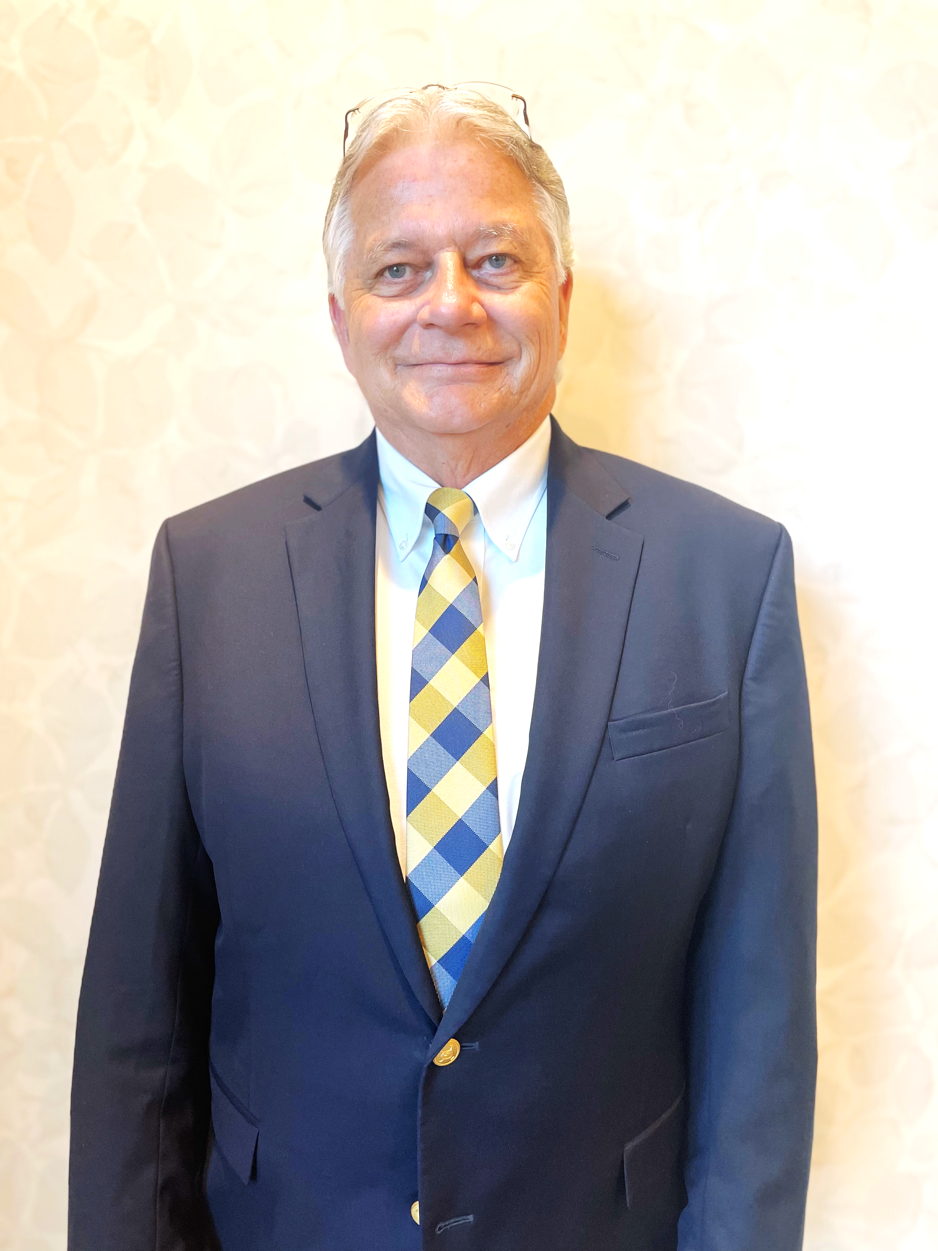
SILVER BEAVER PRESENTER
Roy Garner

Slide 21
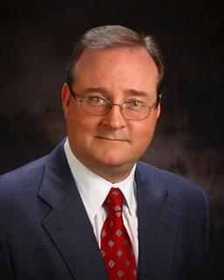
JAMES “CURRAN”
BOWEN

Slide 22
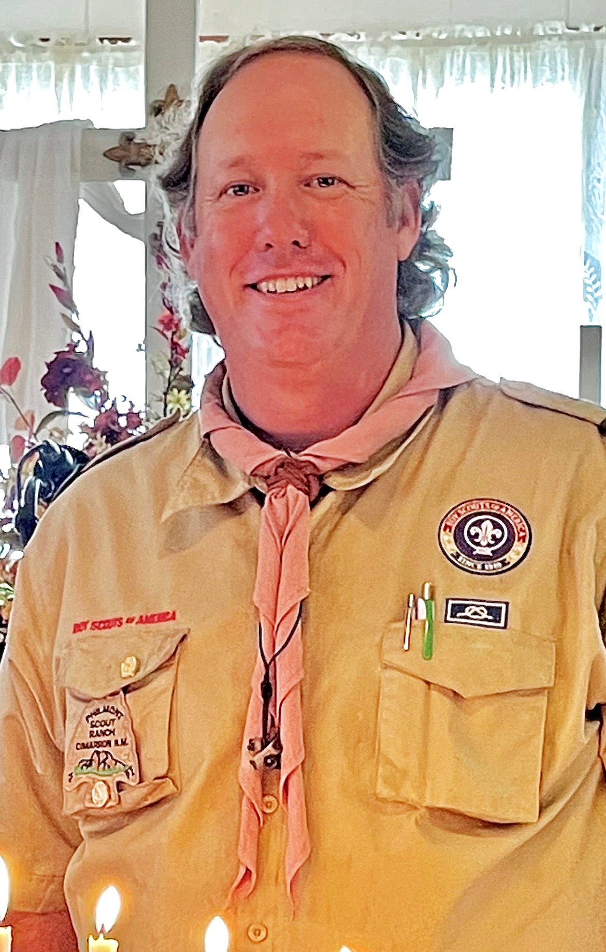
JOHN GASSETT

Slide 23
Silver Beaver Awards

Slide 24
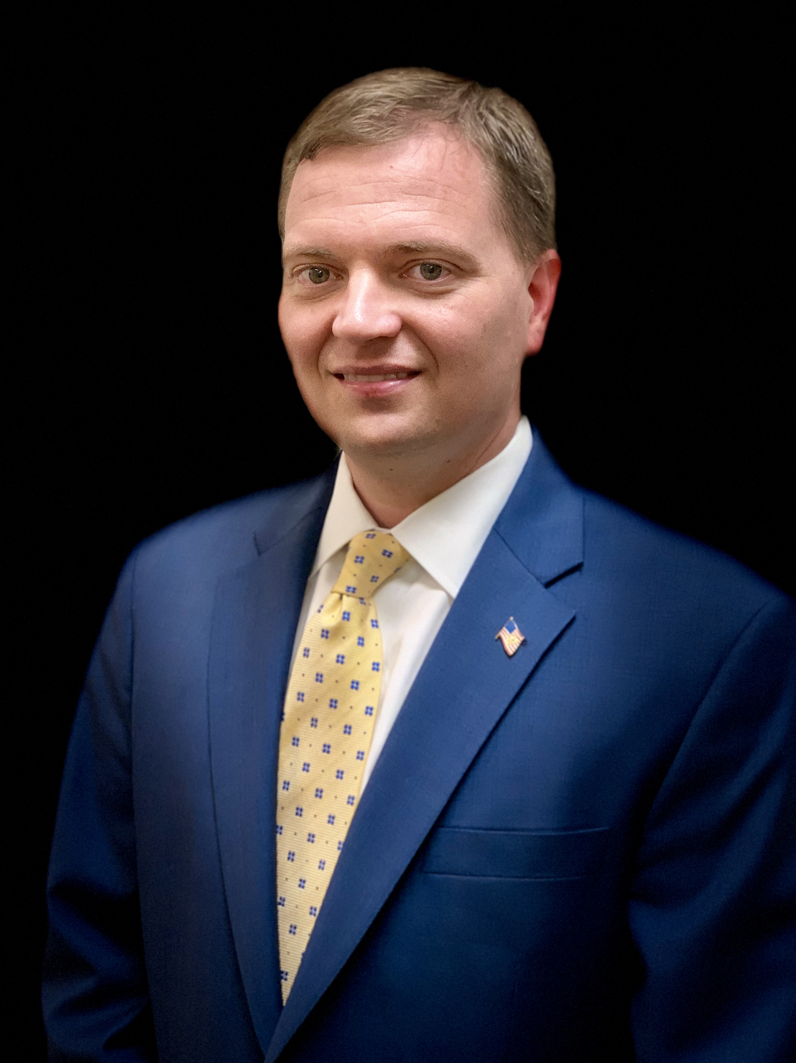
Scout Executive, Robert Johnson

Slide 25
Council President, Jay Fralish

Slide 26
Master of Ceremonies
Bill Baldwin

Slide 27
Thank You For Coming!
See You Next Year!

Slide 28
The Flint River Council would like to thank…
Oak Hill Baptist Church
Expressed Moments Catering
Ken Couch (AV)

